Slide 1
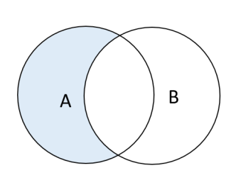

EXCEPT
EXCEPT operator is used to return all rows in the first SELECT statement that are not returned by the second SELECT statement.
SELECT customer_idFROM sales_2015
WHERE customer_id
NOT IN
(SELECT customer_idFROM customer_20_60ORDER BY customer_id);
Syntax

Slide 2
INSERT
The INSERT INTO statement is used to add new records into a database table
Single row (without column names specified)
INSERT INTO customer_table
VALUES (1, ‘bee', ’cee’, 32, ‘bc@xyz.com’ );
Single row (with column names specified)
INSERT INTO customer_table ( cust_id, first_name, age, email_id)
VALUES (2, ‘dee', 22, ‘d@xyz.com’);
Multiple rows
INSERT INTO customer_table
VALUES (1, ‘ee', ’ef’, 35, ‘ef@xyz.com’ ),
(1, ‘gee', ’eh’, 42, ‘gh@xyz.com’ ),
(1, ‘eye', ’jay’, 62, ‘ij@xyz.com’ ),
(1, ‘kay', ’el’, , ‘el@xyz.com’ );
Example

